Slide 1
Data Visualization and Graphical Representation of Data

Slide 2
Data Visualization
Data Visualization is the process of representing data using graphical elements such as charts, graphs, and plots to make the data easier to understand and analyze.
Humans understand pictures much faster than numbers.
It transforms raw data → visual representation so that humans can quickly detect
Patterns
Trends
Relationships
outliers

Slide 3
Why Data Visualization
Gain insight into an information space by mapping data onto graphical primitives
Provide qualitative overview of large data sets
Search for patterns, trends, structure, irregularities, relationships among data
Help find interesting regions and suitable parameters for further quantitative analysis
Provide a visual proof of computer representations derived

Slide 4
Basic Statistical Descriptions of Data
Central Tendency
Dispersion of Data
Graphic Displays

Slide 5
Central Tendency
Mean
Median
Mode

Slide 6
Measuring the Dispersion of Data
Quartiles, outliers and boxplots
Quantile: data points that split the data distribution into equal-size consecutive sets.
Quartiles: Q₁ (25th percentile), Q₃ (75th percentile)
Inter-quartile range: IQR = Q₃ – Q₁
Five number summary: min, Q₁, median, Q₃, max
Boxplot: ends of the box are the quartiles; median is marked; add whiskers, and plot outliers individually
Outlier: usually, a value higher/lower than 1.5 x IQR

Slide 7
Measuring the Dispersion of Data
Variance and standard deviation (sample: s, population: σ)
Variance: (algebraic, scalable computation)
Standard deviation s (or σ) is the square root of variance s² ⁽or σ²⁾

Slide 8
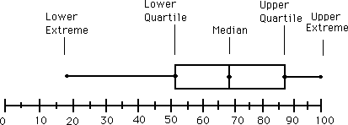
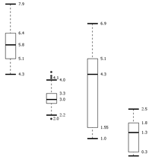
Boxplot Analysis
Five-number summary of a distribution
Minimum, Q1, Median, Q3, Maximum
Boxplot
Data is represented with a box
The ends of the box are at the first and third quartiles, i.e., the height of the box is IQR
The median is marked by a line within the box
Whiskers: two lines outside the box extended to Minimum and Maximum
Outliers: points beyond a specified outlier threshold, plotted individually

Slide 9
Graphic Displays
Boxplot: graphic display of five-number summary
Histogram: x-axis are values, y-axis represents frequencies
Quantile plot: each value x_{i} is paired with f_{i} indicating that approximately 100 f_{i} % of data are ≤ x_{i}
Quantile-quantile (q-q) plot: graphs the quantiles of one univariate distribution against the corresponding quantiles of another
Scatter plot: each pair of values is a pair of coordinates and plotted as points in the plane

Slide 10
Visualization of Data Distribution
Histogram
A histogram is a graphical representation of the frequency distribution of continuous data.
Represented using rectangular bars
Shows how data is distributed across value ranges
X-axis: intervals (bins) of continuous values
Y-axis: frequency of observations
Used to visualize the distribution of numerical data
Bars touch each other because the data is continuous
Example: Distribution of students’ marks

Slide 11
Histogram Analysis
Graph display of tabulated frequencies, shown as bars
It shows what proportion of cases fall into each of several categories
The categories are usually specified as non-overlapping intervals of some variable. The categories (bars) must be adjacent

Slide 12
Histograms Often Tell More than Boxplots
The two histograms shown in the left may have the same boxplot representation
The same values for: min, Q1, median, Q3, max
But they have rather different data distributions

Slide 13
Categorical Data Visualization
Bar Chart
Categorical data
Comparison between groups
Bars have gaps
Example: Departments and the number of students

Slide 14
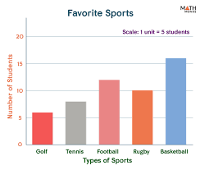
Barchart/bar diagram
Bar diagram consists of a series of rectangular bars of equal width
The bars stand on common base line with equal gap between one bar and another
The bar may be either horizontal or vertical

Slide 15
Histogram vs Bar Chart
Feature | Histogram | Bar Chart
Data type | Continuous | Categorical
Bars | Touch each other | Have gaps
Purpose | Distribution | Comparison
Example | Exam scores | Department enrollment

Slide 16
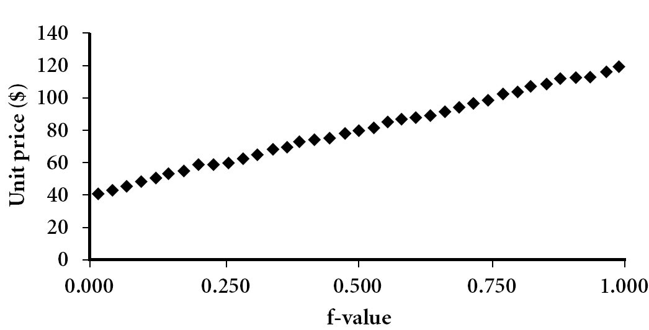
Quantile Based Visualization
Displays all of the data (allowing the user to assess both the overall behavior and unusual occurrences)
Plots quantile information
For a data x_{i} data sorted in increasing order, f_{i} indicates that approximately 100 f_{i}% of the data are below or equal to the value x_{i}

Slide 17
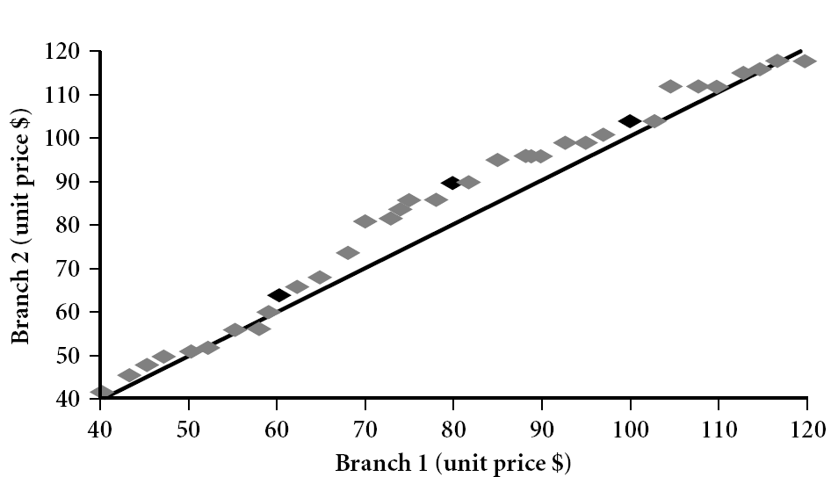
Quantile-Quantile (Q-Q) Plot
Graphs the quantiles of one univariate distribution against the corresponding quantiles of another
View: Is there is a shift in going from one distribution to another?
Example shows unit price of items sold at Branch 1 vs. Branch 2 for each quantile. Unit prices of items sold at Branch 1 tend to be lower than those at Branch 2.

Slide 18
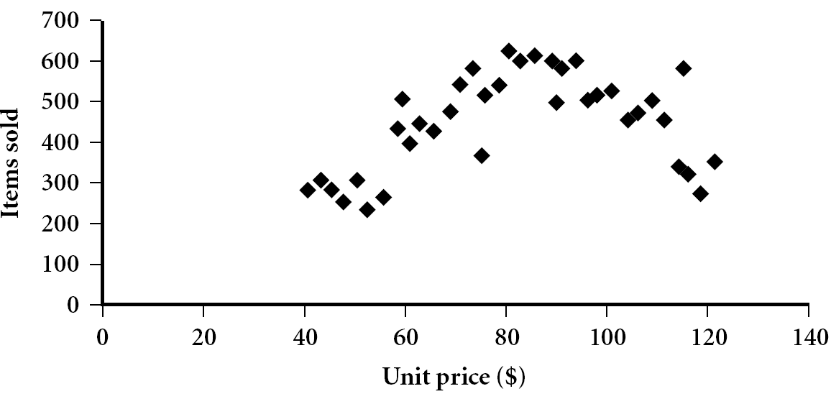
Relationship Visualization: Scatter plot
Provides a first look at bivariate data to see clusters of points, outliers, etc
Each pair of values is treated as a pair of coordinates and plotted as points in the plane

Slide 19
Positively and Negatively Correlated Data
The left half fragment is positively correlated
The right half is negative correlated

Slide 20
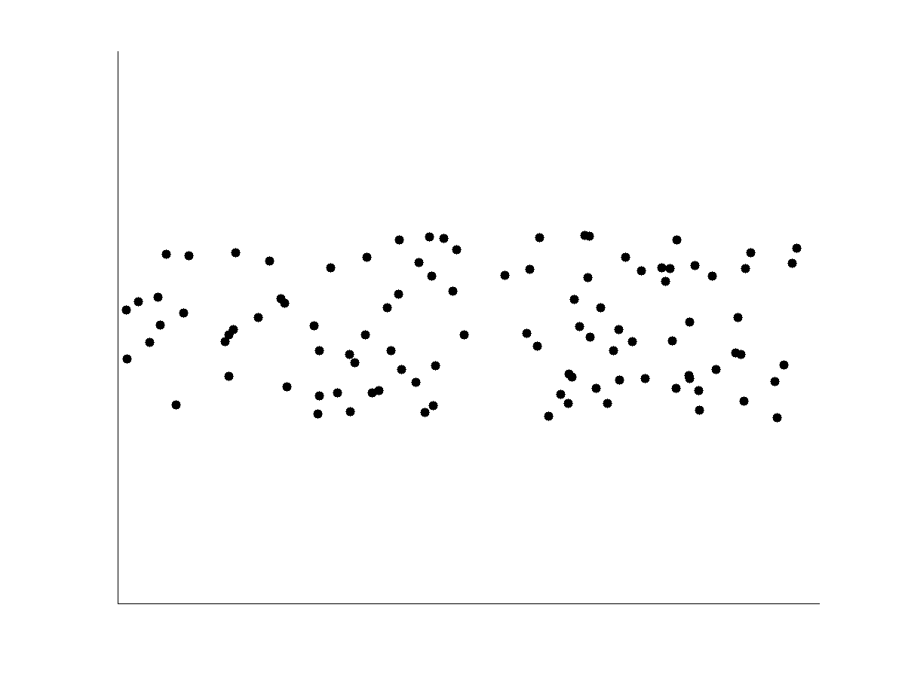
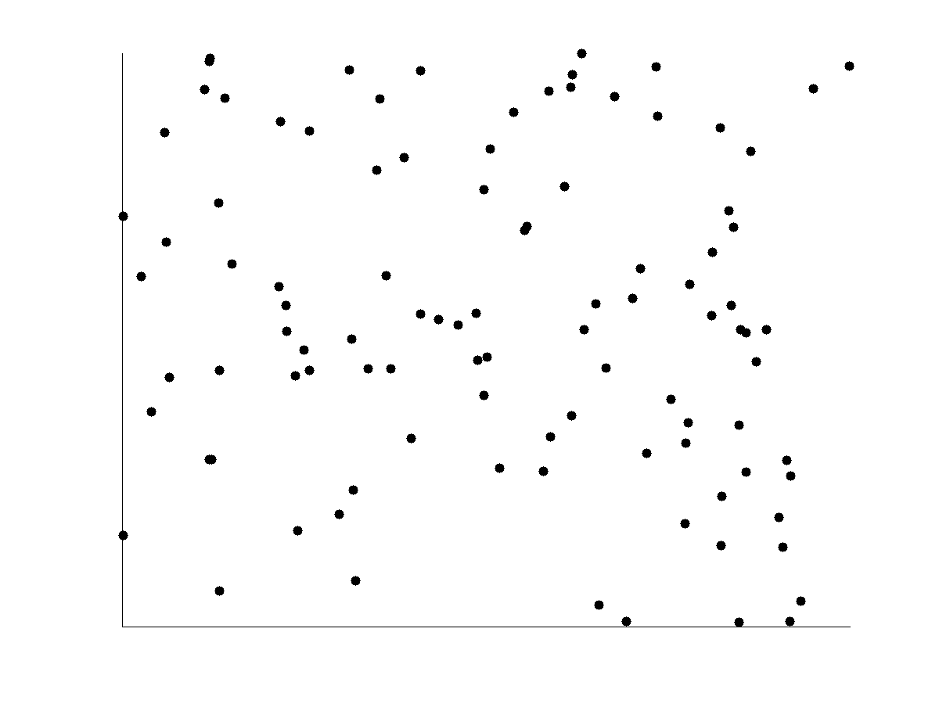
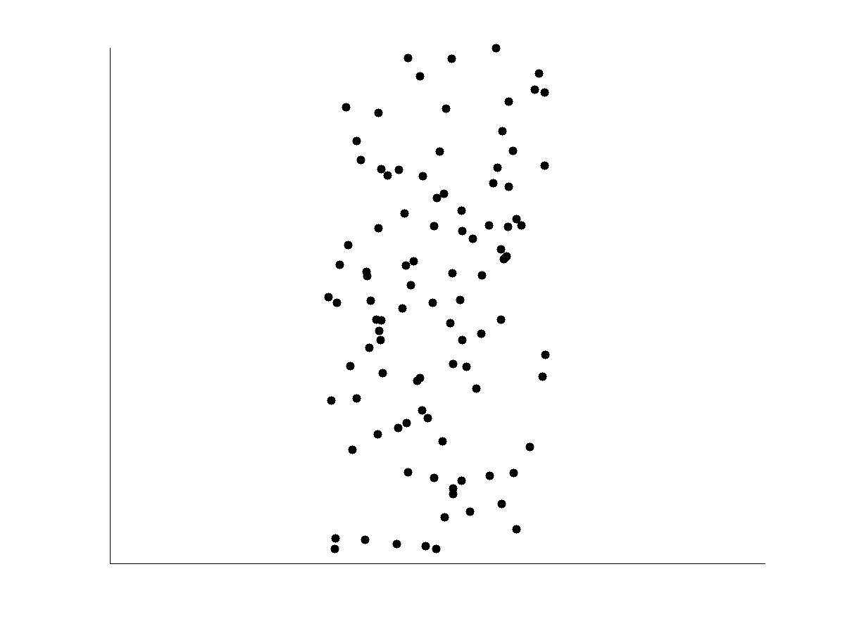
Uncorrelated Data

Slide 21
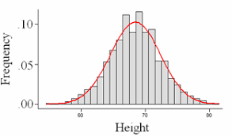
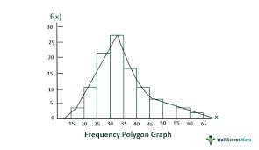
Frequency curve
Variables is taken along the X-axis and frequencies along Y-axis
Frequencies are plotted against the class mid-values and then these points are joined by a smooth curve
Total area under the frequency curve represents total frequency

Slide 22
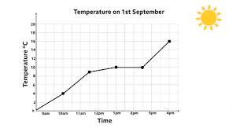
Line graphs
Line graphs are used to display the comparison between two variables which are plotted on the X-axis and Y-axis
The X-axis represents measures of time, while the Y-axis represents percentage or measures of quantity
Line graphs displays a change in direction
It shows trend of an event occurring over a period of time to know whether it is increased or decreased.

Slide 23
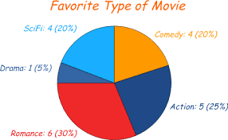
Pie diagram
Presenting discrete data of qualitative characteristics such as blood groups, Age group, causes of mortality etc.
The frequencies of the groups are shown in a circle
Degrees of angle denote the frequency and area of the sector

Slide 24
Heat Map
A heatmap is a data visualization technique that represents values using colors.
Heatmaps are often used to visualize correlation matrices in machine learning.
It helps quickly identify patterns, relationships, or intensity of values in a dataset.
Key Characteristics
Data values are represented by different colors
Each cell represents a value in a matrix or table
Darker or stronger colors indicate higher values
Lighter colors indicate lower values
Common Use: correlation matrix, confusion matrix

Slide 25
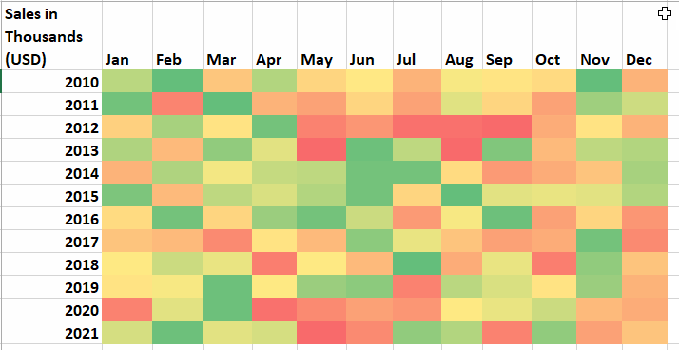
Heat Map

Slide 26
Geometric Projection Visualization
Visualization of geometric transformations and projections of the data
Challenge
How to visualize a high-dimensional spaceon a 2-D display?
Methods
Scatterplot and scatterplot matrices
Parallel coordinates

Slide 27
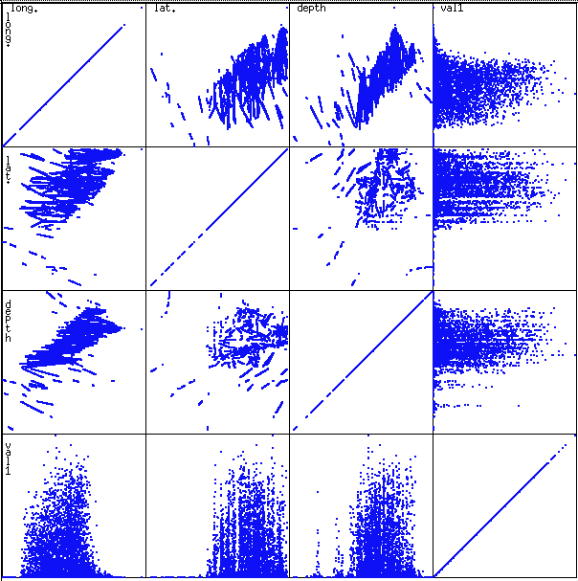
Scatterplot Matrices
Used by ermission of M. Ward, Worcester Polytechnic Institute
Matrix of scatterplots (x-y-diagrams) of the k-dim. data [total of (k2/2-k) scatterplots]

Slide 28
Parallel Coordinates
n equidistant axes which are parallel to one of the screen axes and correspond to the attributes
The axes are scaled to the [minimum, maximum]: range of the corresponding attribute
Every data item corresponds to a polygonal line which intersects each of the axes at the point which corresponds to the value for the attribute

Slide 29
Hierarchical Visualization Techniques
Visualization of the data using a hierarchical partitioning into subspaces
Example Methods
Worlds-within-Worlds
Tree-Map

Slide 30
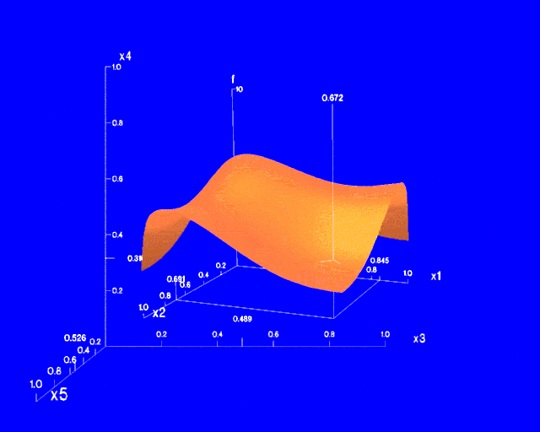
Worlds-within-Worlds
Assign the function and two most important parameters to innermost world
Fix all other parameters at constant values - draw other (1 or 2 or 3 dimensional worlds choosing these as the axes)
Software that uses this paradigm

Slide 31
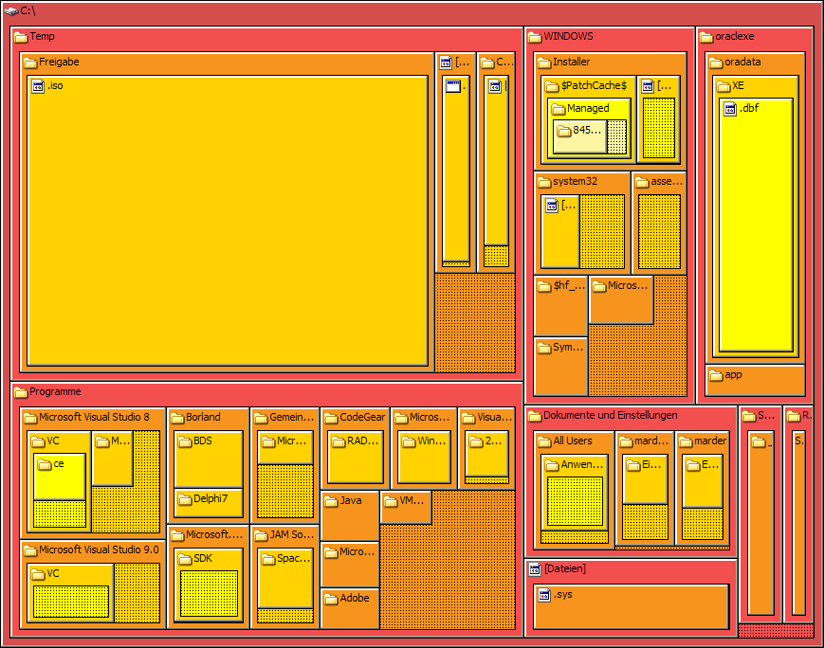
Tree-Maps
Treemaps display hierarchical (tree-structured) data as a set of nested rectangles. Each branch of the tree is given a rectangle, which is then tiled with smaller rectangles representing sub-branches.
Notes:
Picture: http://upload.wikimedia.org/wikipedia/commons/8/8b/Tree_Map.png

Slide 32
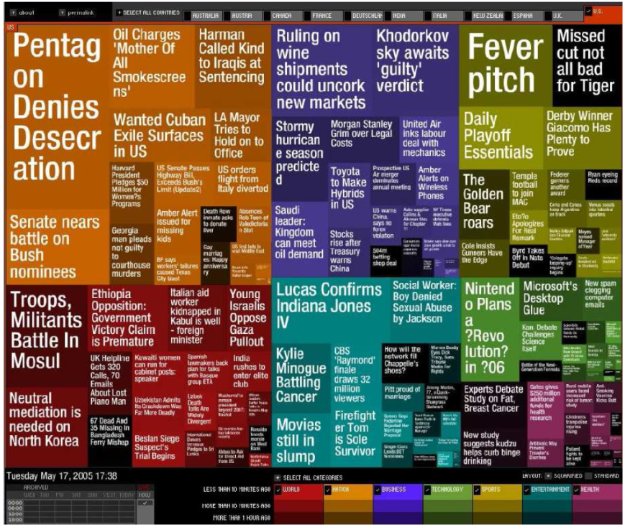
Visualizing Complex Data and Relations
Visualizing non-numerical data: text and social networks
Tag cloud: visualizing user-generated tags
The importance of tag is represented by font size/color
Besides text data, there are also methods to visualize relationships, such as visualizing social networks
Notes:
http://nadeausoftware.com/articles/visualization

